Slide 1
Title of Topic: Relational Algebra, Domain Relational Calculus, Tuple Relational Calculus Course Code: 23IT201 Course Title: DataBase Management Systems Session Number: 4 Academic Year: 2024 – 2025 (Even Sem)
Relational Algebra, Domain Relational Calculus, Tuple Relational
MODULE 1-INTRODUCTION

Slide 2
1. Introduction to DBMS, Characteristics of DBMS, DBMS vs File Systems, need for DBMS. 2. Three Level DBMS Architecture 3. Data Models Introduction, Benefits, and Phases 4. ER Diagrams – Symbols, Components, Relationships, Weak entities, Attributes, Cardinality. 5. Relational Algebra, Domain Relational Calculus, Tuple Relational 6.Calculus Keys - primary Key, Foreign Key.
Relational Algebra, Domain Relational Calculus, Tuple Relational
Module 1 – Data Modeling and Relational Query Language
MODULE 1-INTRODUCTION
2

Slide 3
Relational Algebra, Domain Relational Calculus, Tuple Relational
Relational Algebra, Domain Relational Calculus, Tuple Relational Calculus
Topics to be Covered
Relational Algebra
Schema for the University Database
Select Operation (σ)
Project Operation (∏)
Union Operation (∪)
Set Difference Operation (–)
Set-Intersection Operation (∩)
Cartesian-Product Operation (x)
Rename Operation (ρ)
Natural-Join Operation
Assignment Operation
Generalized Projection
Aggregate Functions
Tuple Relational Calculus
Domain Relational Calculus
MODULE 1-INTRODUCTION

Slide 4
Relational Algebra, Domain Relational Calculus, Tuple Relational
Relational Algebra
Procedural language
Six basic operators
select: σ
project: ∏
union: ∪
set difference: –
Cartesian product: x
rename: ρ
The operators take one or two relations as inputs and produce a new relation as a result
Other operations are set intersection, natural join, and assignment
MODULE 1-INTRODUCTION

Slide 5

Relational Algebra, Domain Relational Calculus, Tuple Relational
Schema for the University DataBase
Instructor(ID, name, dept_name ,salary)
Teaches(ID ,course_id ,sec_id, semester, year)
Takes(ID ,course_id ,sec_id,semester, year,grade)
Section(course_id, sec_id,semester,year,building,room_no,time_slot_id)
Student( ID,name,dept_name,tot_cred)
Classroom(building, room_no,capacity)
Department(dept_name,building,Budget)
Course(course_id, title,dept_name,credits)
Relational Algebra: Part-I: Part-II: Part-III:
MODULE 1-INTRODUCTION

Slide 6
Relational Algebra, Domain Relational Calculus, Tuple Relational
Select Operation (σ)
The select operation selects tuples that satisfy a given predicate.
Notation: σ _{p}(r), where p is called the selection predicate
Defined as: σ_{p}(r) = {t | t ∈ r and p(t)} Where p is a formula in propositional calculus consisting of terms connected by : ∧ (and), ∨ (or), ¬ (not)
Each term is one of: <attribute> op <attribute> or <constant>
where op is one of: =, ≠, >, ≥. <. ≤
E.g., σ _{dept_name=“Physics”}(instructor)
MODULE 1-INTRODUCTION

Slide 7
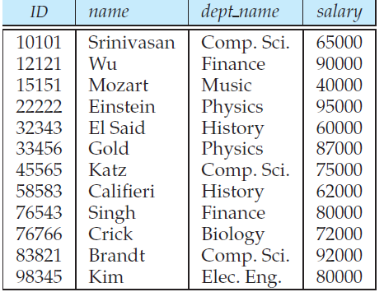
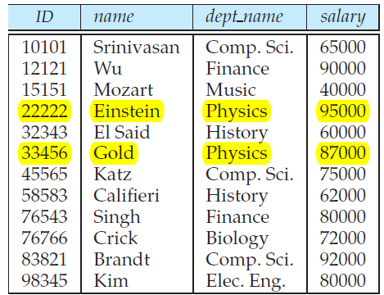

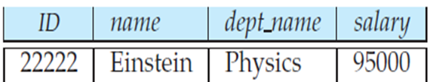
Relational Algebra, Domain Relational Calculus, Tuple Relational
Select Operation (σ)
σ _{dept_name=“Physics”}(instructor)
The instructor relation
σ _{dept_name=“Physics”}(instructor)
σ dept_name =“Physics”∧ salary>90000 (instructor)
MODULE 1-INTRODUCTION

Slide 8
Relational Algebra, Domain Relational Calculus, Tuple Relational
Project Operation (∏)
The project operation is a unary operation that returns its argument relation, with certain attributes left out. Since a relation is a set, any duplicate rows are eliminated
Notation: ∏ A_{1,} A_{2,} A₃(r), where A₁, A₂ are attribute names and r is a relation name
The result is defined as the relation of k columns obtained by erasing the columns that are not listed
Duplicate rows removed from result, since relations are sets
E.g., To eliminate the dept_name attribute of instructor
∏_{ID, name, salary} (instructor)
MODULE 1-INTRODUCTION

Slide 9
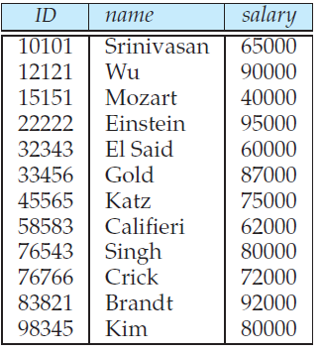
Relational Algebra, Domain Relational Calculus, Tuple Relational
Project Operation (∏)
∏_{ID, name, salary} (instructor)
The instructor relation
MODULE 1-INTRODUCTION

Slide 10
Relational Algebra, Domain Relational Calculus, Tuple Relational
Union Operation (∪)
Ensure that unions are taken between compatible relations
Notation: r ∪ s
Defined as: r ∪ s = {t | t ∈ r or t ∈ s}
For r ∪ s to be valid:
r, s must have the same arity (same number of attributes)
The attribute domains must be compatible (E.g., 2nd column of r deals with the same type of values as does the 2nd column of s)
E.g., To find all courses taught in the Fall 2009 semester, or in the Spring 2010 semester, or in both
∏_{course_id} (σ_{semester=“Fall” Λ year=2009} (section)) ∪ ∏_{course_id} (σ_{semester=“Spring” Λ year=2010} (section))
MODULE 1-INTRODUCTION

Slide 11
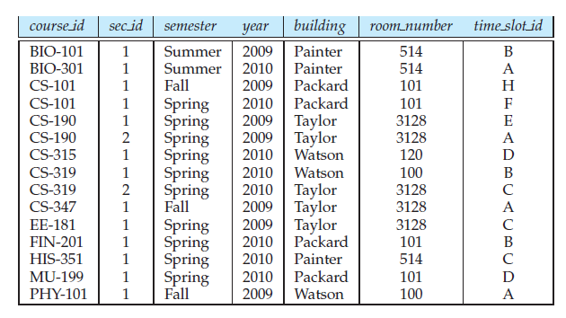
Relational Algebra, Domain Relational Calculus, Tuple Relational
Union Operation (∪)
The section relation
MODULE 1-INTRODUCTION

Slide 12
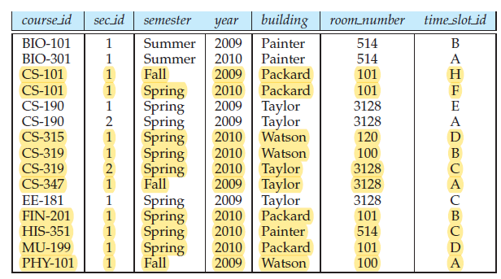
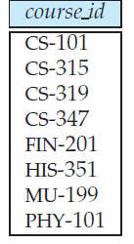
Relational Algebra, Domain Relational Calculus, Tuple Relational
Union Operation (∪)
∏_{course_id} (σ_{semester=“Fall” Λ year=2009} (section)) ∪ ∏_{course_id} (σ_{semester=“Spring” Λ year=2010} (section))
MODULE 1-INTRODUCTION

Slide 13
Relational Algebra, Domain Relational Calculus, Tuple Relational
Set Difference Operation (-)
Allows us to find tuples that are in one relation but are not in another (r – s)
Defined as: r – s = {t | t ∈ r and t ∉ s}
Set differences must be taken between compatible relations
r and s must have the same arity
attribute domains of r and s must be compatible
E.g., To find all courses taught in the Fall 2009 semester, but not in the Spring 2010 semester
∏_{course_id} (σ_{semester=“Fall”} _{Λ year=2009} (section)) - ∏_{course_id} (σ_{semester=“Spring” Λ year=2010} (section))
MODULE 1-INTRODUCTION

Slide 14
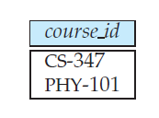
Relational Algebra, Domain Relational Calculus, Tuple Relational
Set Difference Operation (-)
∏_{course_id} (σ_{semester=“Fall”} _{Λ year=2009} (section)) − ∏_{course_id} (σ_{semester=“Spring” Λ year=2010} (section))
MODULE 1-INTRODUCTION

Slide 15
Relational Algebra, Domain Relational Calculus, Tuple Relational
Set-Intersection Operation (∩)
Used to select common rows (tuples) from two tables (relations)
Defined as: r ∩ s = { t | t ∈ r and t ∈ s }
Assume:
r, s have the same arity
attributes of r and s are compatible
Note: r ∩ s = r – (r – s)
E.g., To find the set of all courses taught in both the Fall 2009 and the Spring 2010 semesters
∏_{course_id} (σ_{semester=“Fall” Λ year=2009} (section)) ∩ ∏_{course_id} (σ_{semester=“Spring” Λ year=2010} (section))
MODULE 1-INTRODUCTION

Slide 16

Relational Algebra, Domain Relational Calculus, Tuple Relational
Set-Intersection Operation (∩)
∏_{course_id} (σ_{semester=“Fall”} _{Λ year=2009} (section)) ∩ ∏_{course_id} (σ_{semester=“Spring” Λ year=2010} (section))
MODULE 1-INTRODUCTION

Slide 17
Relational Algebra, Domain Relational Calculus, Tuple Relational
Cartesian-Product Operation (×)
Allows to combine information from any two relations
Defined as: r x s = {t q | t ∈ r and q ∈ s}
Assume that attributes of r(R) and s(S) are disjoint. (That is, R ∩ S = ∅)
If attributes of r(R) and s(S) are not disjoint, then renaming must be used
n1 tuples in instructor and n2 tuples in teaches then there are n1 ∗ n2 ways of choosing a pair of tuples; so there are n1 ∗ n2 tuples in r x s
E.g., Schema is Instructor(ID, name, dept_name, salary) and Teaches(ID, course_id, sec_id, semester, year)
To find the names of all instructors in the Physics department together with the course id of all courses they taught
∏_{name, courseid}(σ_{instructor.ID=teaches.ID}(σ_{deptname=“Physics”}(instructor × teaches)))
MODULE 1-INTRODUCTION

Slide 18
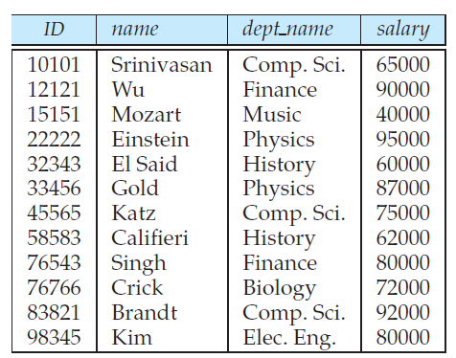
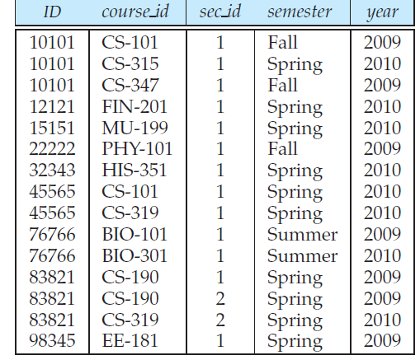
Relational Algebra, Domain Relational Calculus, Tuple Relational
Cartesian-Product Operation (×)
The instructor relation
The teaches relation
MODULE 1-INTRODUCTION

Slide 19
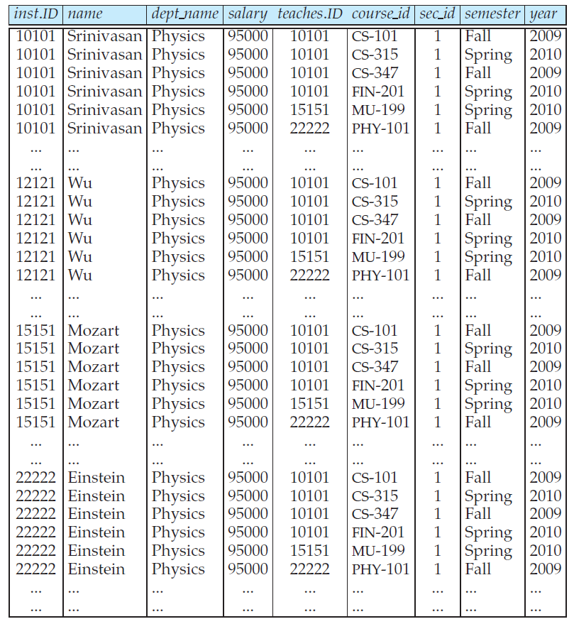
Relational Algebra, Domain Relational Calculus, Tuple Relational
Cartesian-Product Operation (×)
r = instructor × teaches is: (instructor.ID, instructor.name, instructor.dept_name, instructor.salary, teaches.ID, teaches.course_id, teaches.sec_id, teaches.semester, teaches.year)
MODULE 1-INTRODUCTION

Slide 20

Relational Algebra, Domain Relational Calculus, Tuple Relational
Rename Operation (ρ)
Used to rename a relation or an attribute or an algebraic expression of a relation and is denoted by the lowercase Greek letter ρ rho ()
E.g., ρ _{x} (E) returns the expression E under the name X
If a relational-algebra expression E has arity n, then
returns the result of expression E under the name X, and with the attributes renamed to A₁ , A₂ , …., A_{n}
To find the highest salary in the university with schema Instructor(ID, name, dept_name ,salary)
MODULE 1-INTRODUCTION

Slide 21
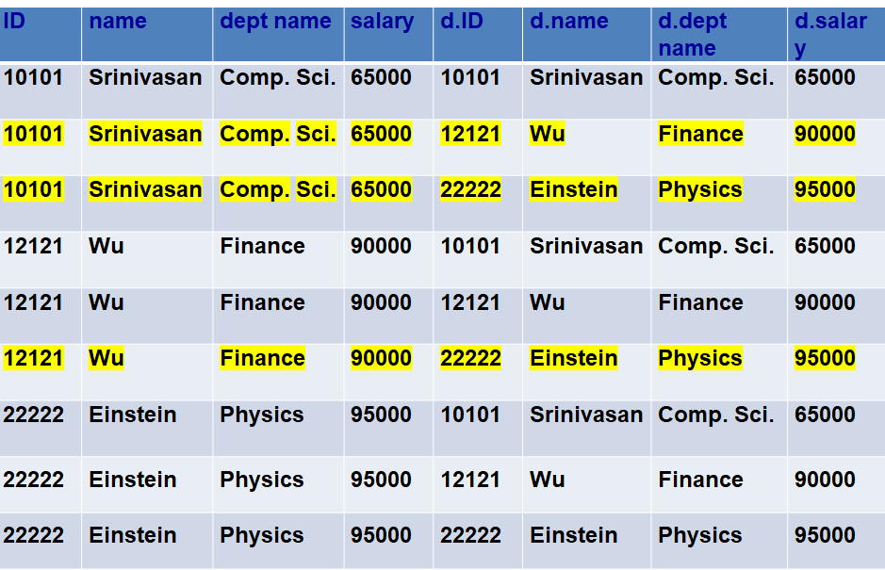
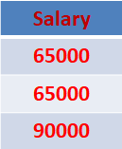
Relational Algebra, Domain Relational Calculus, Tuple Relational
Rename Operation (ρ)
Instructor X d.instructor
Salary that are not the largest
π _{instructor.salary} (σ_{instructor.salary < d.salary} (instructor × ρ_{d} (instructor)))
MODULE 1-INTRODUCTION

Slide 22

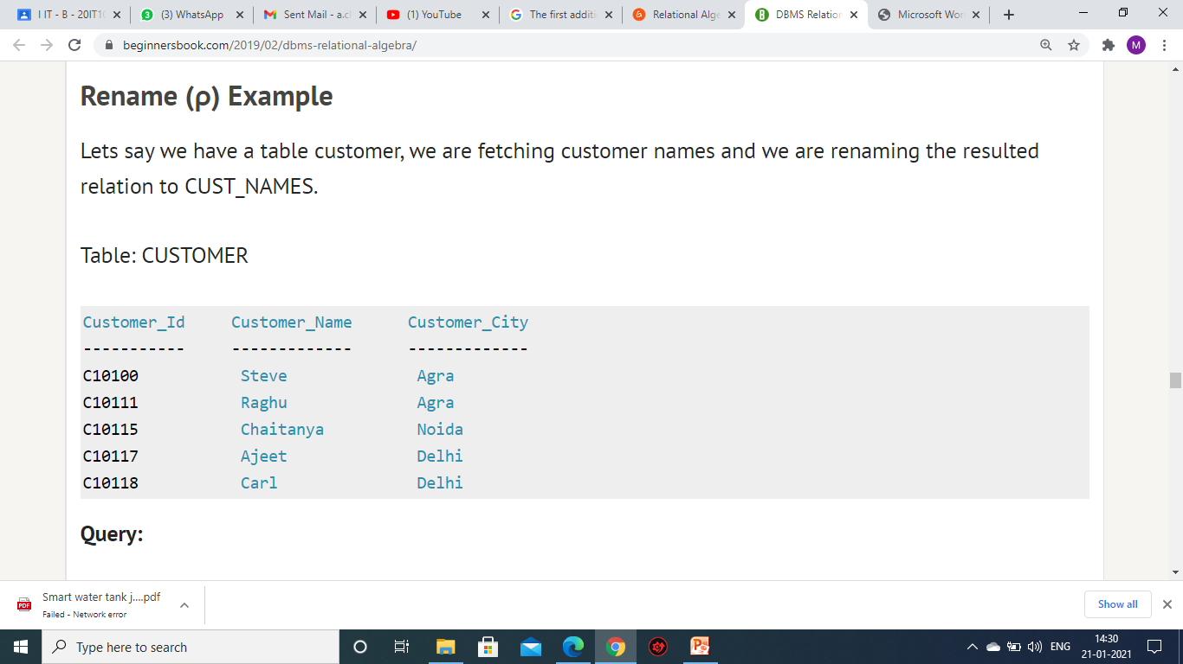
Relational Algebra, Domain Relational Calculus, Tuple Relational
Rename Operation (ρ)
Largest Salary
π_{salary} (instructor) - π_{instructor.salary} (σ_{instructor.salary < d.salary} (instructor × ρ_{d} (instructor)))
Compute first a temporary relation consisting of those salaries that are not the largest and
Take the set difference between the relation salary (instructor) and the temporary relation just computed, to obtain the result
To fetch customer names from customer relation and to rename the resulted relation to CUST_NAMES
The customer relation
MODULE 1-INTRODUCTION

Slide 23
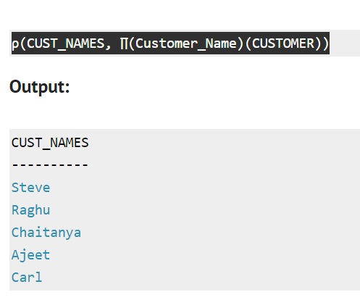
Relational Algebra, Domain Relational Calculus, Tuple Relational
Rename Operation (ρ)
ρ(_{CUST_NAMES}, ∏_{(Customer_Name)} (CUSTOMER))
MODULE 1-INTRODUCTION

Slide 24
Relational Algebra, Domain Relational Calculus, Tuple Relational
Natural-Join Operation
Binary operation that allows us to combine certain selections and a cartesian product into one operation
Denoted by the join symbol
r s
Let r and s be relations on schemas R and S respectively. The result is a relation on schema R S
E.g., R = (A, B, C, D) and S = (E, B, D), then Result schema = (A, B, C, D, E)
r s is defined as: ∏_{r.A, r.B, r.C, r.D, s.E} (σ_{r.B = s.B r.D = s.D} (r x s))
Note: If r(R) and s(S) are relations without any attributes in common, that is, R ∩ S = ∅, then r s = r × s
MODULE 1-INTRODUCTION

Slide 25
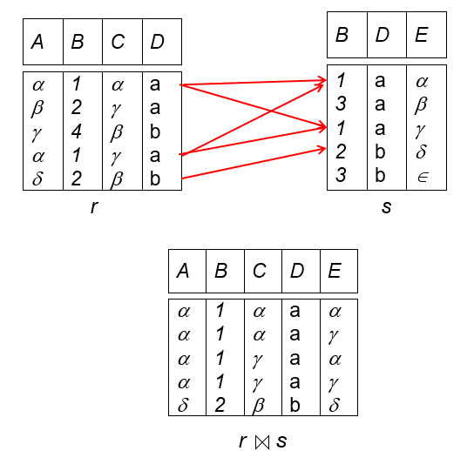
Relational Algebra, Domain Relational Calculus, Tuple Relational
Natural-Join Operation
Relations r, s:
MODULE 1-INTRODUCTION

Slide 26
Relational Algebra, Domain Relational Calculus, Tuple Relational
Assignment Operation
Relational-algebra expression assign a part of a temporary relation variables using assignment operation (←)
Assignment must always be made to a temporary relation variable
E.g., temp1 ← R × S, temp2 ← σ r.A1 =s.A1 ∧ r.A2 =s.A2 ∧...∧ r.An =s.An (temp1), then Result = ∏ _{R ∪ S} (temp2)
The result to the right of the ← is assigned to the relation variable on the left of the ←
May use variable in subsequent expressions
MODULE 1-INTRODUCTION

Slide 27
Relational Algebra, Domain Relational Calculus, Tuple Relational
Generalized Projection
Extends the projection operation by allowing arithmetic functions to be used in the projection list
∏ _{F1, F2, …, Fn}(E) where E is any relational-algebra expression
Each of F₁, F₂, …, F_{n} are arithmetic expressions involving constants and attributes in the schema of E
E.g., ∏ _{ID, name, dept name, salary÷12}(instructor) gives the ID, name, dept name, and the monthly salary of each instructor
MODULE 1-INTRODUCTION

Slide 28
Relational Algebra, Domain Relational Calculus, Tuple Relational
Aggregate Functions
Takes a collection of values and returns a single value as a result
avg: average value, min: minimum value, max: maximum value, sum: sum of values, count: number of values
Aggregate operation in relational algebra _{G1, G2, …, Gn} g _{F1( A1), F2( A2),…, Fn( An)} (E)
Here, E is any relational-algebra expression
G₁, G₂ …, G_{n} is a list of attributes on which to group (can be empty), Each F_{i} is an aggregate function, Each A_{i} is an attribute name
E.g.1, To find the average salary in each department
_{dept_name} G _{average(salary)}(instructor)
E.g.2, To find out the sum of salaries of all instructors G_{sum}(salary)(instructor)
MODULE 1-INTRODUCTION

Slide 29
Relational Algebra, Domain Relational Calculus, Tuple Relational
Tuple Relational Calculus
A non-procedural query language, where each query is of the form {t | P (t ) }
Set of all tuples t such that predicate P is true for t and t is a tuple variable
t ∈ r denotes that tuple t is in relation r and P is similar to predicate calculus
Predicate Calculus includes
Set of attributes and constants
Set of comparison operators: (e.g., <, ≤, =, ≠, >, ≥)
Set of connectives: and (∧), or (v)‚ not (¬)
Implication (⇒): x ⇒ y, if x if true, then y is true means x ⇒ y ≡ ¬x v y
Set of quantifiers:
∃t ∈ r (Q(t)) ≡ ”there exists” a tuple in t in relation r
∀t ∈ r (Q(t)) ≡ Q is true “for all” tuples t in relation r
MODULE 1-INTRODUCTION

Slide 30
Relational Algebra, Domain Relational Calculus, Tuple Relational
Tuple Relational Calculus
Schema for the University Database
Instructor(ID,name,dept_name,salary)
Teaches(ID,course_id,sec_id,semester,year)
Takes(ID,course_id,sec_id,semester,year,grade)
Section(course_id,sec_id,semester,year,building,room_no,time_slot_id)
Student(ID,name,dept_name,tot_cred)
Classroom(building,room_no,capacity)
Department(dept_name,building,Budget)
Course(course_id,title,dept_name,credits)
Relational Calculus:
MODULE 1-INTRODUCTION

Slide 31
Relational Algebra, Domain Relational Calculus, Tuple Relational
Tuple Relational Calculus
Example Queries
To find the ID, name, dept_name, salary for instructors whose salary is greater than $80,000
{t | t ∈ instructor ∧ t [salary ] > 80000}
Notice that a relation on schema (ID, name, dept_name, salary) is implicitly defined by the query
As in the previous query, but output only the ID attribute value
{t | ∃ s ∈ instructor (t [ID ] = s [ID ] ∧ s [salary ] > 80000)}
Notice that a relation on schema (ID) is implicitly defined by the query
Tuple Relational Calculus: Part-I: Part-II:
MODULE 1-INTRODUCTION

Slide 32
Relational Algebra, Domain Relational Calculus, Tuple Relational
Tuple Relational Calculus
Example Queries
To find the names of all instructors whose department is in the Watson building
{t | ∃s ∈ instructor (t [name ] = s [name ] ∧ ∃u ∈ department (u [dept_name ] = s[dept_name] ∧ u [building] = “Watson” ))}
To find the set of all courses taught in the Fall 2009 semester, or in the Spring 2010 semester, or both
{t | ∃s ∈ section (t [course_id ] = s [course_id ] ∧ s [semester] = “Fall” ∧ s [year] = 2009 v ∃u ∈ section (t [course_id ] = u [course_id ] ∧ u [semester] = “Spring” ∧ u [year] = 2010 )}
MODULE 1-INTRODUCTION

Slide 33
Relational Algebra, Domain Relational Calculus, Tuple Relational
Tuple Relational Calculus
Example Queries
To find the set of all courses taught in the Fall 2009 semester, and in the Spring 2010 semester
{t | ∃s ∈ section (t [course_id ] = s [course_id ] ∧ s [semester] = “Fall” ∧ s [year] = 2009 ∧ ∃u ∈ section (t [course_id ] = u [course_id ] ∧ u [semester] = “Spring” ∧ u [year] = 2010 )}
To find the set of all courses taught in the Fall 2009 semester, but not in the Spring 2010 semester
{t | ∃s ∈ section (t [course_id ] = s [course_id ] ∧ s [semester] = “Fall” ∧ s [year] = 2009 ∧ ¬ ∃u ∈ section (t [course_id ] = u [course_id ] ∧ u [semester] = “Spring” ∧ u [year] = 2010 )}
MODULE 1-INTRODUCTION

Slide 34
Relational Algebra, Domain Relational Calculus, Tuple Relational
Tuple Relational Calculus
Universal Quantification
To find all students who have taken all courses offered in the Biology department
{t | ∃ r ∈ student (t [ID] = r [ID]) ∧ (∀ u ∈ course (u [dept_name]=“Biology” ⇒ ∃ s ∈ takes (t [ID] = s [ID ] ∧ s [course_id] = u [course_id]))}
Safety of Expressions
Possible to write tuple calculus expressions that generate infinite relations
E.g., { t | ¬ t ∈ r } results in an infinite relation if the domain of any attribute of relation r is infinite
To guard against the problem, restrict the set of allowable expressions to safe expressions
MODULE 1-INTRODUCTION

Slide 35
Relational Algebra, Domain Relational Calculus, Tuple Relational
Tuple Relational Calculus
An expression {t | P (t )} is safe if every component of t appears in one of the relations, tuples, or constants that appear in P
Note: This is more than just a syntax condition
E.g., { t | t [A] = 5 ∨ true } is not safe --- it defines an infinite set with attribute values that do not appear in any relation or tuples or constants in P
Consider again that query to find all students who have taken all courses offered in the Biology department
{t | ∃ r ∈ student (t [ID] = r [ID]) ∧ (∀ u ∈ course (u [dept_name]=“Biology” ⇒ ∃ s ∈ takes (t [ID] = s [ID ] ∧ s [course_id] = u [course_id]))}
Without the existential quantification on student, the above query would be unsafe if the Biology department has not offered any courses
MODULE 1-INTRODUCTION

Slide 36
Relational Algebra, Domain Relational Calculus, Tuple Relational
Domain Relational Calculus
A nonprocedural query language equivalent in power to the tuple relational calculus
Each query is an expression of the form: { < x₁, x₂, …, x_{n} > | P (x₁, x₂, …, x_{n})}
x₁, x₂, …, x_{n} represent domain variables
P represents a formula similar to that of the predicate calculus
Example Queries
To find the ID, name, dept_name, salary for instructors whose salary is greater than $80,000
{< i, n, d, s> | < i, n, d, s> ∈ instructor ∧ s > 80000}
As in the previous query, but output only the ID attribute value
{< i> | < i, n, d, s> ∈ instructor ∧ s > 80000}
MODULE 1-INTRODUCTION

Slide 37
Relational Algebra, Domain Relational Calculus, Tuple Relational
Domain Relational Calculus
Example Queries
To find the names of all instructors whose department is in the Watson building
{< n > | ∃ i, d, s (< i, n, d, s > ∈ instructor ∧ ∃ b, a (< d, b, a> ∈ department ∧ b = “Watson” ))}
To find the set of all courses taught in the Fall 2009 semester, or in the Spring 2010 semester, or both
{<c> | ∃ a, s, y, b, r, t ( <c, a, s, y, b, r, t > ∈ section ∧ s = “Fall” ∧ y = 2009 ) v ∃ a, s, y, b, r, t ( <c, a, s, y, b, r, t > ∈ section ] ∧ s = “Spring” ∧ y = 2010)}
Domain Relational Calculus: Part-I: Part-II:
MODULE 1-INTRODUCTION

Slide 38
Relational Algebra, Domain Relational Calculus, Tuple Relational
Domain Relational Calculus
Example Queries
This case can also be written as
{<c> | ∃ a, s, y, b, r, t ( <c, a, s, y, b, r, t > ∈ section ∧ ( (s = “Fall” ∧ y = 2009) v (s = “Spring” ∧ y = 2010))}
To find the set of all courses taught in the Fall 2009 semester, and in the Spring 2010 semester
{<c> | ∃ a, s, y, b, r, t ( <c, a, s, y, b, r, t > ∈ section ∧ s = “Fall” ∧ y = 2009) ∧ ∃ a, s, y, b, r, t ( <c, a, s, y, b, r, t > ∈ section] ∧ s = “Spring” ∧ y = 2010)}
MODULE 1-INTRODUCTION

Slide 39
Relational Algebra, Domain Relational Calculus, Tuple Relational
Domain Relational Calculus
Safety of Expressions
The expression: { < x₁, x₂, …, x_{n} > | P (x₁, x₂, …, x_{n} )} is safe if all of the following hold:
All values that appear in tuples of the expression are values from dom (P) (that is, the values appear either in P or in a tuple of a relation mentioned in P)
For every “there exists” subformula of the form ∃ x (P₁(x)), the subformula is true if and only if there is a value of x in dom (P₁) such that P₁(x) is true
For every “for all” subformula of the form ∀_{x} (P₁ (x)), the subformula is true if and only if P₁(x) is true for all values x from dom (P₁)
MODULE 1-INTRODUCTION

Slide 40
Relational Algebra, Domain Relational Calculus, Tuple Relational
Domain Relational Calculus
Universal Quantification
To find all students who have taken all courses offered in the Biology department
{< i > | ∃ n, d, tc ( < i, n, d, tc > ∈ student ∧ (∀ ci, ti, dn, cr ( < ci, ti, dn, cr > ∈ course ∧ dn =“Biology” ⇒ ∃ si, se, y, g ( <i, ci, si, se, y, g> ∈ takes ))}
Note: Without the existential quantification on student, the above query would be unsafe if the Biology department has not offered any courses
MODULE 1-INTRODUCTION

Slide 41
Relational Algebra, Domain Relational Calculus, Tuple Relational
Relational Algebra, Domain Relational Calculus, Tuple Relational Calculus
Summary
Relational Algebra
Schema for the University Database
Select Operation (σ)
Project Operation (∏)
Union Operation (∪)
Set Difference Operation (–)
Set-Intersection Operation (∩)
Cartesian-Product Operation (x)
Rename Operation (ρ)
Natural-Join Operation
Assignment Operation
Generalized Projection
Aggregate Functions
Tuple Relational Calculus
Domain Relational Calculus
MODULE 1-INTRODUCTION

Slide 42
Relational Algebra, Domain Relational Calculus, Tuple Relational
Relational Algebra, Relational Calculus – Fundamental Operations
Try Yourself
Write the queries in relational algebra, using the university schema.
Find the titles of courses in the Comp. Sci. department that have 3 credits.
Find the IDs of all students who were taught by an instructor named Einstein; make sure there are no duplicates in the result.
Find the highest salary of any instructor.
Find all instructors earning the highest salary (there may be more than one with the same salary).
Find the enrollment of each section that was offered in Autumn 2009.
Find the maximum enrollment, across all sections, in Autumn 2009.
Find the sections that had the maximum enrollment in Autumn 2009.
MODULE 1-INTRODUCTION

Slide 43
Relational Algebra, Domain Relational Calculus, Tuple Relational
Relational Algebra, Domain Relational Calculus, Tuple Relational Calculus
Try Yourself
2. Consider the employee database
employee (person name, street, city )
works (person name, company name, salary)
company (company name, city)
manages (person name, manager name)
Consider the relational database of employee, where the primary keys are underlined. Give an expression in the relational algebra to express each of the following queries:
Find the names of all employees who live in the same city and on the same street as do their managers.
MODULE 1-INTRODUCTION

Slide 44
Relational Algebra, Domain Relational Calculus, Tuple Relational
Relational Algebra, Domain Relational Calculus, Tuple Relational Calculus
Try Yourself
Find the names of all employees in this database who do not work for “First Bank Corporation”.
Find the names of all employees who earn more than every employee of “Small Bank Corporation”.
Find all employees who work directly for “Jones”.
Find all cities of residence of all employees who work directly for “Jones”.
Find the name of the manager of the manager of “Jones”.
Find those employees who earn more than all employees living in the city “Mumbai”.
MODULE 1-INTRODUCTION

Slide 45
Relational Algebra, Domain Relational Calculus, Tuple Relational
Session 5 – KEYS-PRIMARY KEY, FOREIGN KEY
MODULE 1-INTRODUCTION

